Slide 1
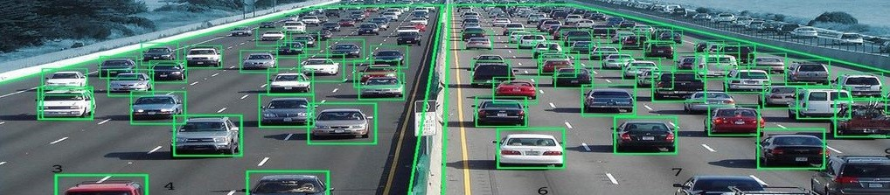
SMART TRAFFIC MANAGEMENT SYSTEM USING IoT
BY-
Anuj Kumar Gupta(Roll no:-18700117077)
Sambhavi(Roll no:-18700117040)
Aayush Mantri(Roll no:-18700117088)
Raja Jha(Roll no:-18700117048)
Kumar Aman(Roll no:-18700117061)
Under the guidance of-
Prof. Debraj Chatterjee

Slide 2
INTRODUCTION
Traffic management is one of the biggest infrastructure hurdles faced by developing countries today.
Developed countries and smart cities are already using IoT to their advantage to minimize issues related to traffic.
So, in order to solve these problems or to minimize them to satisfactory level, newer schemes need to be implemented by using sensor-based automatic traffic signaling system.
So, we propose here a mechanism or a model using IoT in which the time period of green light, yellow light and red light is assigned on the basis of density of the traffic present at that time.

Slide 3
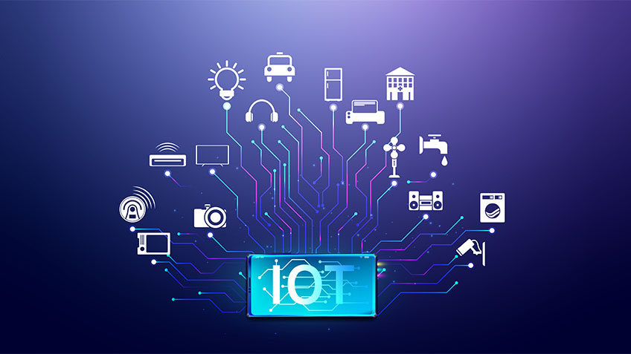
ABOUT IOT
The Internet of Things (IoT), also referred to as the Internet of Everything (IoE)
These devices can talk to the other and related devices and can act accordingly.
This technology helps in providing us with a real-time information
It can be used to monitor our homes, offices, close-ones and families remotely to keep them safe and secure.

Slide 4
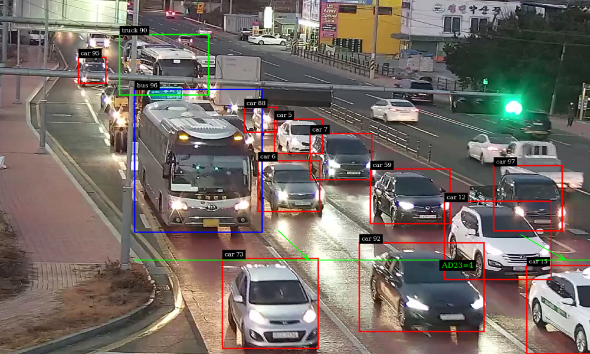
IOT IN TRAFFIC MANAGEMENT
Using IoT billions of physical devices are connected through the Internet, all collecting and sharing data.
Using IoT we can take our manual traffic system to the next level.
Infrared Sensor(IR) can help us to count the number of the vehicles.
Radio-Frequency Sensors(RF) can be used for dealing with special cases as it has transmitting and receiving components.
Microcontroller can play the role of the brain for collecting data and making decisions.

Slide 5
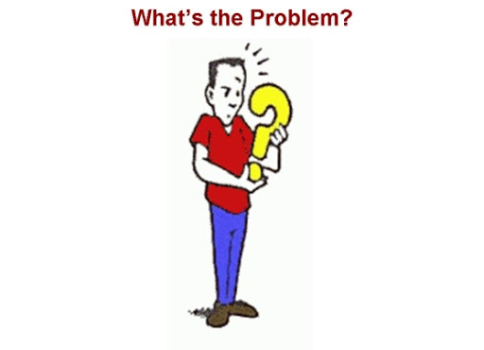
PROBLEM DEFINITION
PRESENT SIGNALING SYSTEM:
Under present scenario, traffic control is achieved by the use of a system of hand signs by traffic police personnel, traffic signals and marking.
Under current circumstances, traffic lights are set on in the different directions with fixed time delay, following a particular cycle while switching from one signal to another.
Not having any mechanism to deal vehicles stuck in traffic rather than clearing route manually by police personnels.
More number of manpower is required.

Slide 6

PROPOSED MODEL
Rather than using fixed time interval signaling system for each lane we are here introducing dynamic signaling system in which the prioritization of each lane happen based on the density of each lane.
Based on the high to lower density traffic signals will be opened first to last respectively.
Will make traffic signaling system SMARTER.

Slide 7
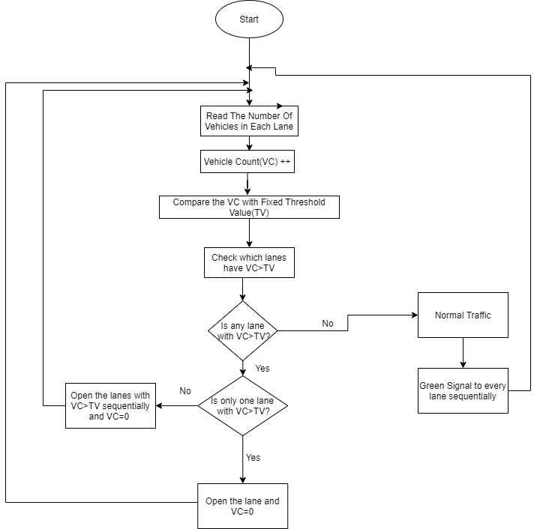
FLOWCHART

Slide 8
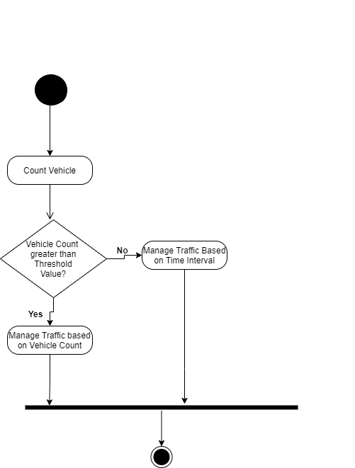
ACTIVITY DIAGRAM

Slide 9
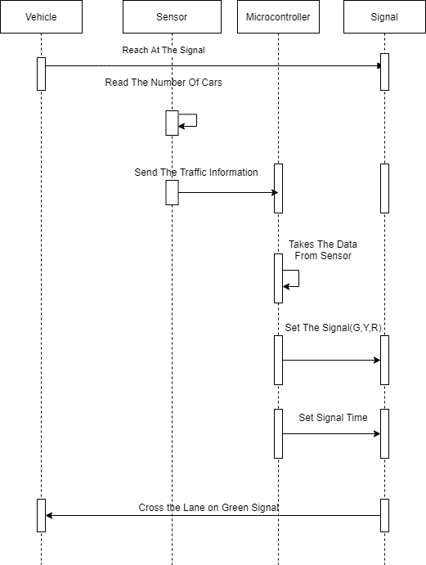
SEQUENCE DIAGRAM

Slide 10
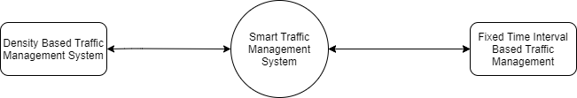
DATA FLOW DIAGRAM(DFD)
Context Level Diagram:

Slide 11
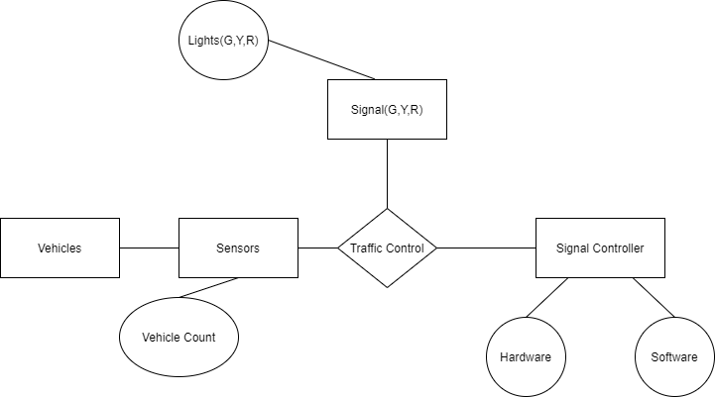
ENTITY RELATIONSHIP DIAGRAM

Slide 12
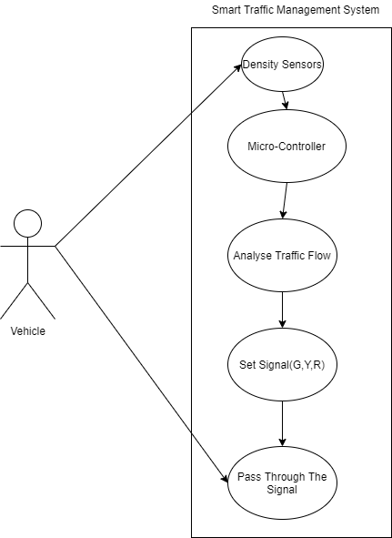
USE CASE DIAGRAM

Slide 13
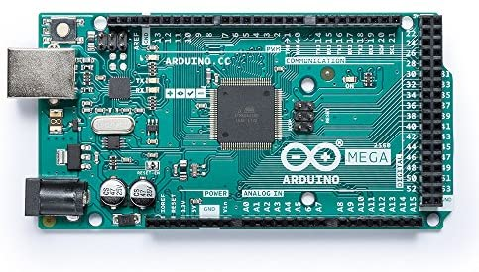
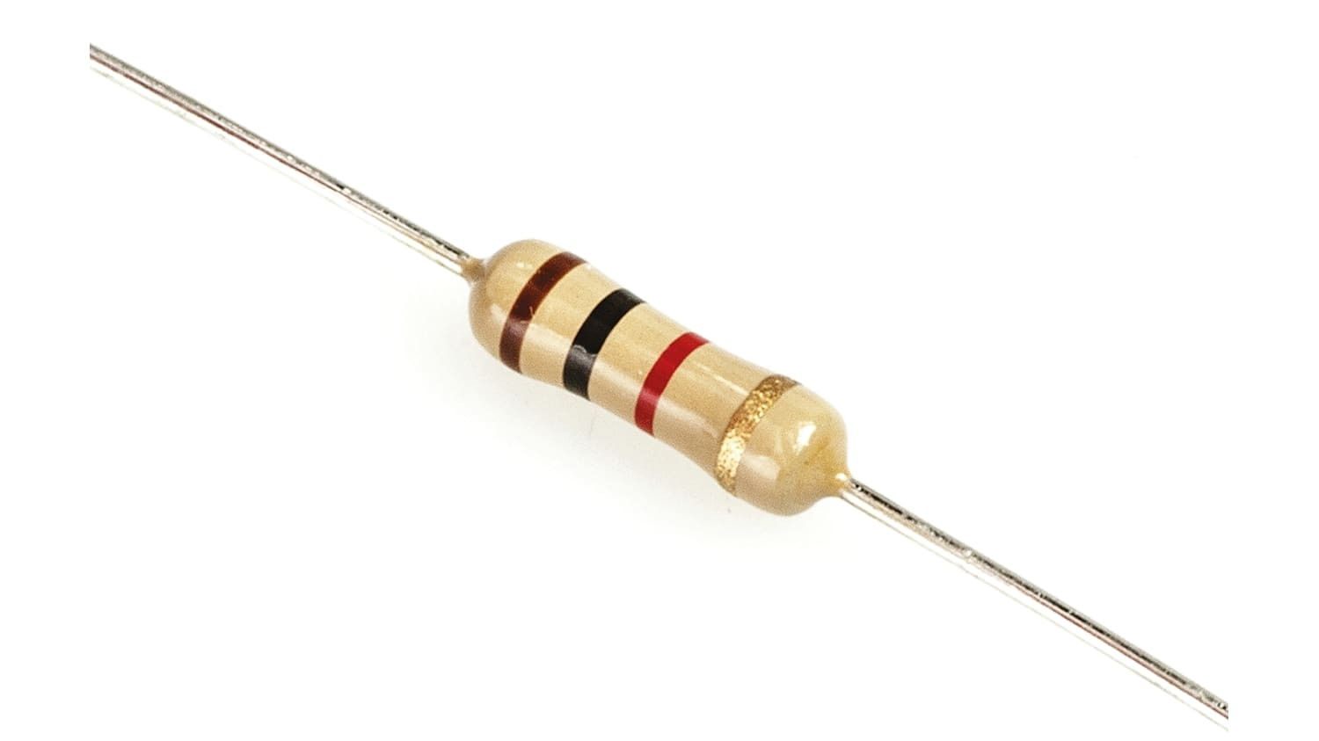
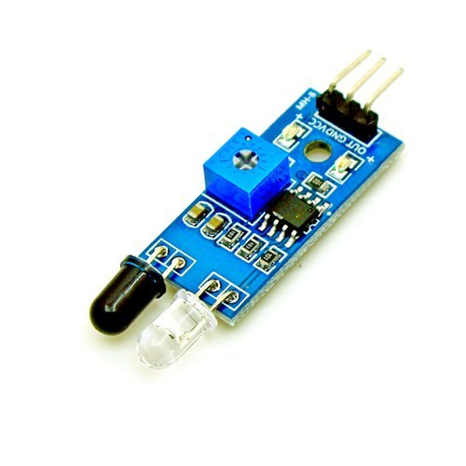
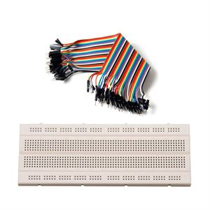
MATERIALS USED
Arduino Mega 2560
Infrared Sensors
Resistors
Jumper Wires
LED Bulbs(Red,Green,Yellow)
USB Cable Type A/B
Breadboard
Connecting Wires

Slide 14
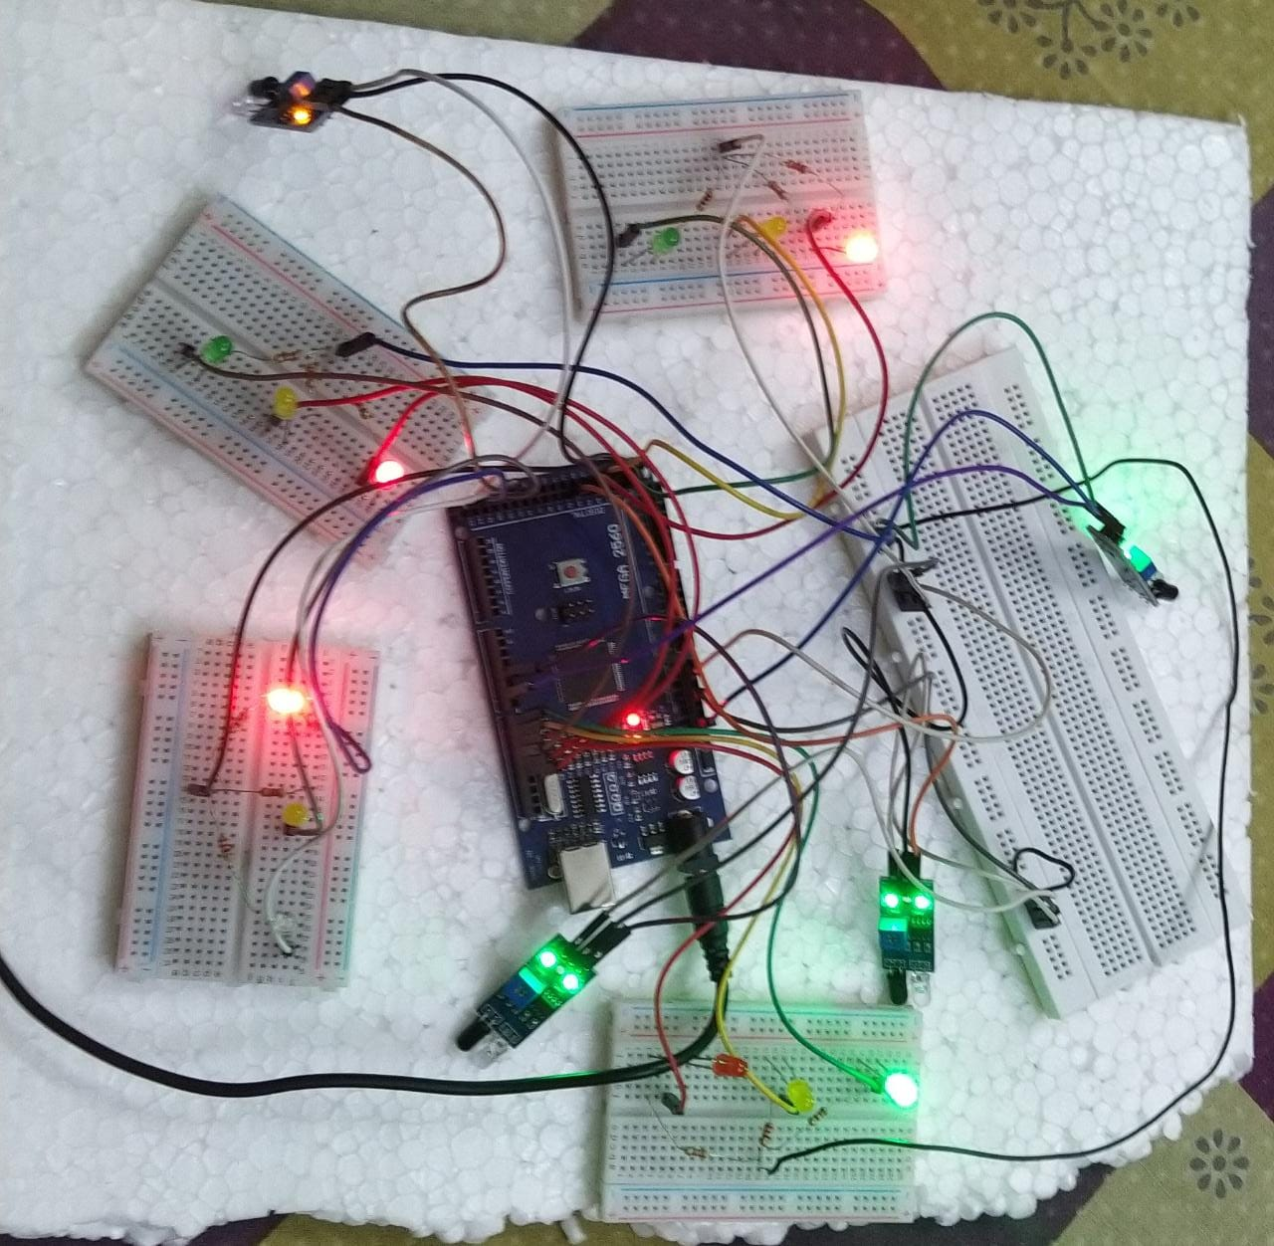
PROJECT MODEL

Slide 15

DEMERITS
Our proposed model doesn’t deal with an emergency vehicle stuck in traffic.
Our model can regulate the flow of traffic based on real time density on each lane which implies it doesn’t have any database concerns and hence it lowers the security of our proposed model.
In special case of maximum density of each lane and due to lower range capacity of our sensors in model , system may behave malfunctionly.

Slide 16

FUTURE SCOPE
For further advancement to our proposed system we have some of the following plans to implement in future so that the gaps in our proposed system could be minimized:
Low Range Sensors such as IR sensors can be replaced with UltraSonic sensors.
For the detection of emergency vehicles RF modules or RFID can be used.
For more security and database concerns we can use “Image Processing based Intelligent Traffic control using Raspberry pi”.
Also we can connect sensor network with GPS connection and short wave radio transmission signal.

Slide 17

CONCLUSION
Our proposed system aims to deliver an effective solution for the rapid growth of traffic worldwide.
The traditional methods have certain limitations as they fail to manage heavy traffic properly. So as a solution our proposed method regulate the traffic signaling system based on the density of traffic on each lane
It changes the signal timing intelligently according to the traffic density and hence, regulates traffic flow.

Slide 18
BIBLIOGRAPHY
Er. Faruk Bin Poyen, Amit Kumar Bhakta, “Density Based Traffic Control”, International Journal of Advanced Engineering Management and Science (IJAEMS), Vol- 2, Aug- 2016,1379-1384
Anam Firdous, Vandana Niranjan, Smart Density Based Traffic Light,2020 8th International Conference on Reliability, Infocom Technologies and Optimization (Trends and Future Directions) (ICRITO), 4-5 June 2020
https://sci-hub.se/https://ieeexplore.ieee.org/abstract/document/9197940
http://centrallibrary.cit.ac.in/dir/Project%20Report/2019/BTech/CSE/Smart%20Traffic%20Management%20System%20using%20Internet%20of%20Things%20%28IoT%29.pdf
https://innovationatwork.ieee.org/6-iot-benefits/
http://www.ir.juit.ac.in:8080/jspui/bitstream/123456789/15666/1/121057.pdf
https://www.rcciit.org/students_projects/projects/ee/2019/GR17.pdf
http://ijariie.com/AdminUploadPdf/DENSITY_BASED_TRAFFIC_LIGHT_CONTROL_USING_ARDUINO_ijariie9121.pdf

Slide 19


